Slide 1
CNX Case Study
Date: May 27, 2025
Reporter: Felicity Fan

Slide 2

Business Background
Client Overview
TelCo Inc. is a telecommunications company facing two major challenges:
Low customer satisfaction (CSAT)
High customer contact volume
Business Concern
TelCo Inc. is worried these issues are:
Damaging brand perception
Reflecting underlying customer pain points that are not well understood

Slide 3
Table of contents
01
02
03
04
Potential Drivers of Low Customer Satisfaction and High Contact Volume
How does the Overall Customer Experience Impact Brand Perception?
What Were the Pain Points During the End-to-end Customer Journey?
Recommendations and Benefits of Implementation

Slide 4

01
Potential Drivers of Low Customer Satisfaction and High Contact Volume

Slide 5
Overview of Customers’ Satisfaction
2.87
3.85
2.48
Average customer experience rating
Average customer experience rating
(1 Contact)
Average customer experience rating
(2 Contacts)
* Rating on the scale of 1~5

Slide 6
Drivers of Satisfaction
What Drives Customers’ Satisfaction?
Drivers | Cramér's V Correlation
Contact Resolution | 0.612
Advisor Role | 0.597
Contact Frequency | 0.564
Contact Reason | 0.437
Issue Resolved Progress | 0.406
Usage of Self-Service Channels | 0.367
Contact Channel | 0.257
Satisfaction has many drivers — let’s dive deeper!
Notes:
Cramér's V is ideal for categorical variables
The correlation between customers overall experience rate and drivers
Use threshold = 0.4

Slide 7
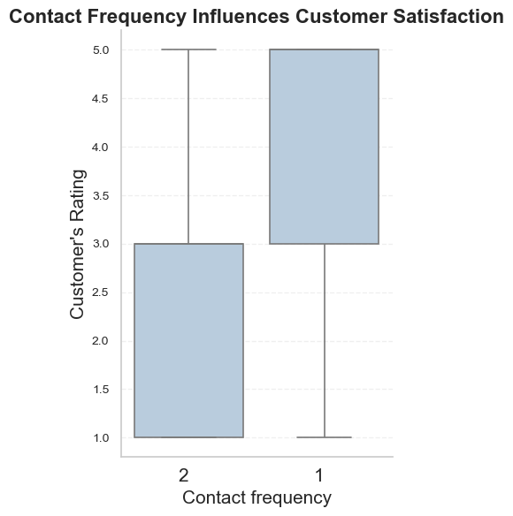
Drivers of Low Satisfaction
Repeat Contacts = Lower Satisfaction

Slide 8
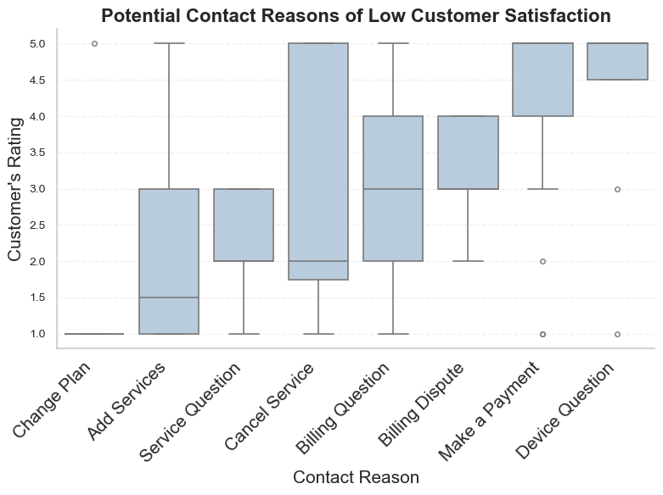
Drivers of Low Satisfaction
Contact reason types with lowest customer satisfaction
⚪ Change Plan
⚪ Add Services
⚪ Service Question
Occasional drops in satisfaction
⚪ Cancel Service
⚪ Billing Questions

Slide 9
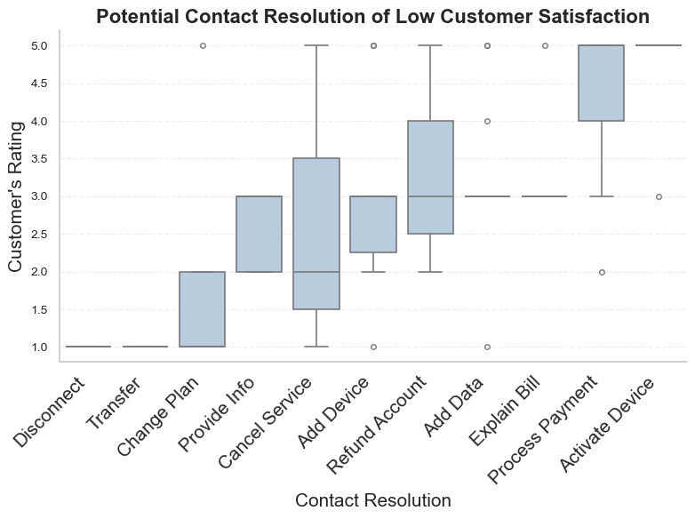
Drivers of Low Satisfaction
Contact resolution types with lowest customer satisfaction
⚪ Disconnect
⚪ Transfer
⚪ Change plan

Slide 10
Repeat Contact Rate
More than half of customers
contact support twice
55%
the number of customers who contact again within 10 days/total customers contacting

Slide 11
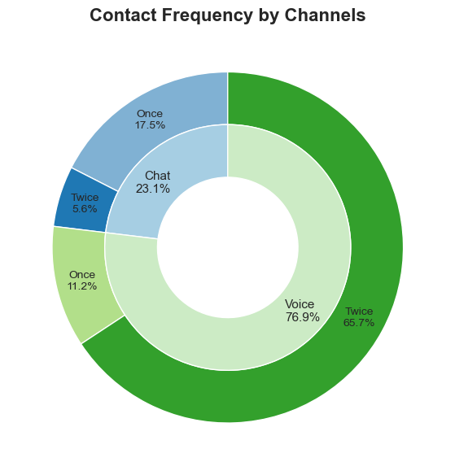
Drivers of High Contact Volume
Voice contacts often result in High Contact Volume

Slide 12
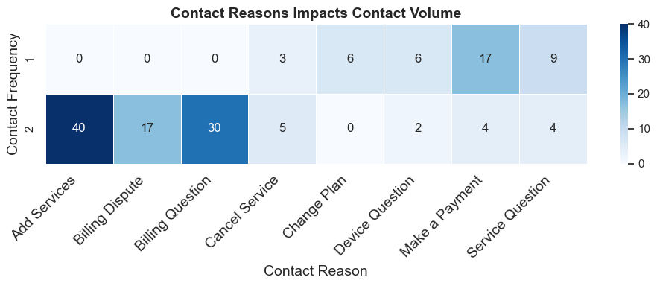
Drivers of High Contact Volume
Drivers (Contact Reason)
of High Contact Volume
⚪ Add Service
⚪ Billing Dispute
⚪ Billing Questions

Slide 13
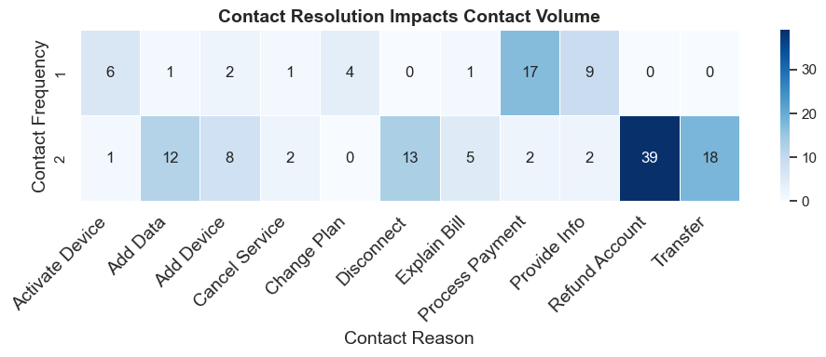
Drivers of High Contact Volume
Drivers (Contact Resolution)
of High Contact Volume
⚪ Refund Account
⚪ Transfer
⚪ Disconnect

Slide 14
02
How does the Overall Customer Experience Impact Brand Perception?

Slide 15
The Impact of Customer Experience on Brand Perception
Customer Experience
NPS Category
What was the customer's rating of their overall experience with this contact?
28%
Detractor
NPS Category: How likely are you to recommend Telco Inc. to a friend or colleague?
54%
Passive
Brand Perception
18%
Promoter

Slide 16
The Impact of Customer Experience on Brand Perception
Customer Experience Correlates with Brand Perception:
NPS Category | Spearman Correlation
Detractor | 0.33
Passive | 0.44
Promoter | 0.57
Better experiences lead to better brand perception —especially among promoters.
Notes:
0-6 are Detractors; 7 and 8 are Passives; 9 and 10 are Promoters
Spearman correlation is ideal for ordinal data

Slide 17
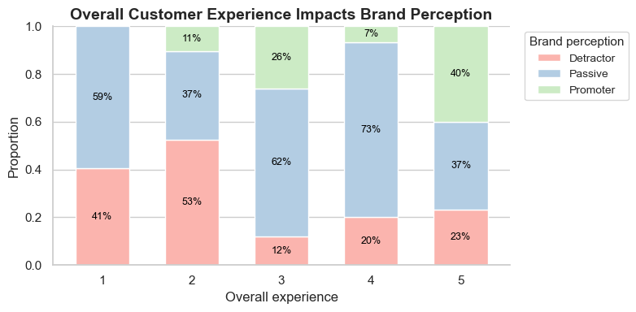
The Impact of Customer Experience on Brand Perception
As customer experience rates improve, more customers likely to recommend the brand.
Poor experiences (rate 1–2) have more detractors.

Slide 18
03
What Were the Pain Points During the End-to-end Customer Journey?

Slide 19
Pain Points
Low Usage of Self-Service Channels
Demand for Experienced Advisors
Low Contact Resolution
Billing and Refund Issues Remain Unresolved

Slide 20
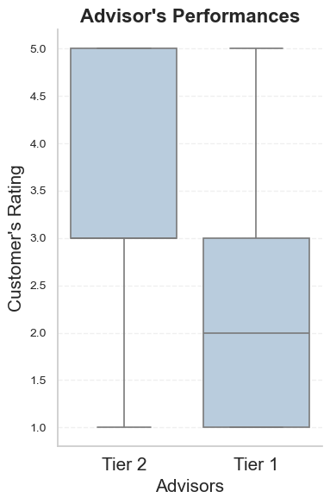
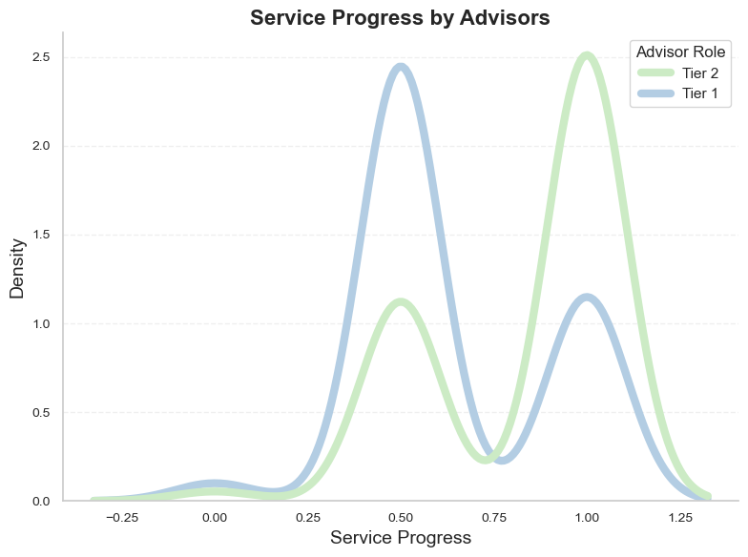
Pain Point 1: Demand for Experienced Advisors
Advisors with longer tenure deliver a better customer experience and smoother service.
Notes:
Issue Resolved? – Service progress
'Yes’: 1;
'No, but expect it to be resolved': 0.5;
'No': 0

Slide 21
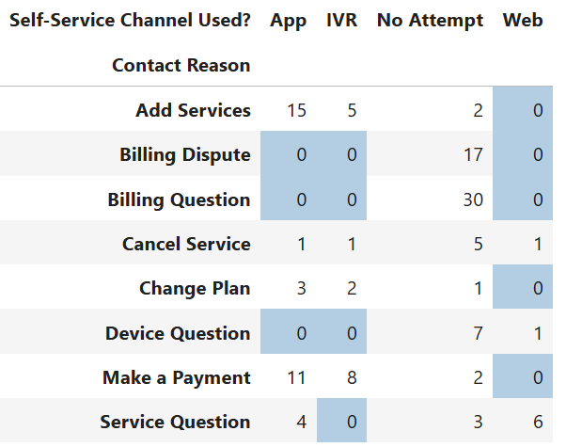
Pain Point 2: Low Usage of Self-Service Channels
53.6% of customers did not attempt to use a self-service channel before contacting support.
No customers used self-service for billing-related issues.

Slide 22
Pain Point 3: Low Contact Resolution
55% customers contacted again
39%
89%
11%
Unresolved repeat contacts are due to cancel service
Remained unresolved.
Unresolved repeat contacts are due to billing issues.

Slide 23
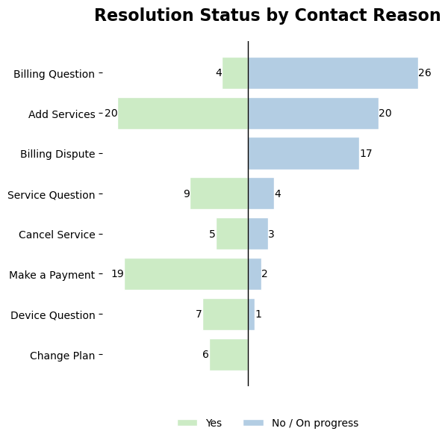
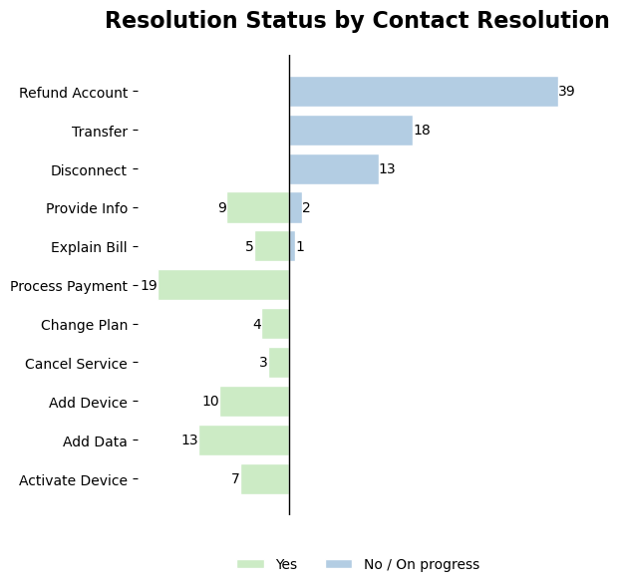
Pain Point 4: Billing and Refund Issues Remain Unresolved

Slide 24
Let’s Uncover More!

Slide 25
64.7%
23.5%
11.8%
Second-time contacts:
Overall experience improved
Overall experience worsened
Overall experience stayed the same

Slide 26
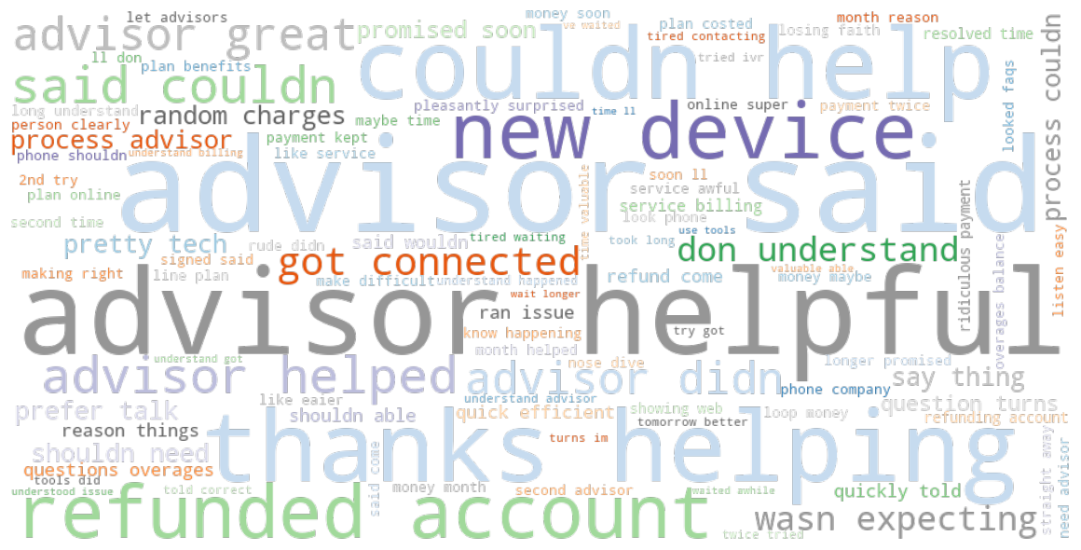

Slide 27
Topic models:
Topic 1 | advisor, understand, don’t, helpful, got, said
Topic 2 | time,, money, issue, better, answer, account
Topic 1: Concerns about advisor communication and clarity.
Topic 2: Frustration with delays, money issues, and unresolved account problems.

Slide 28
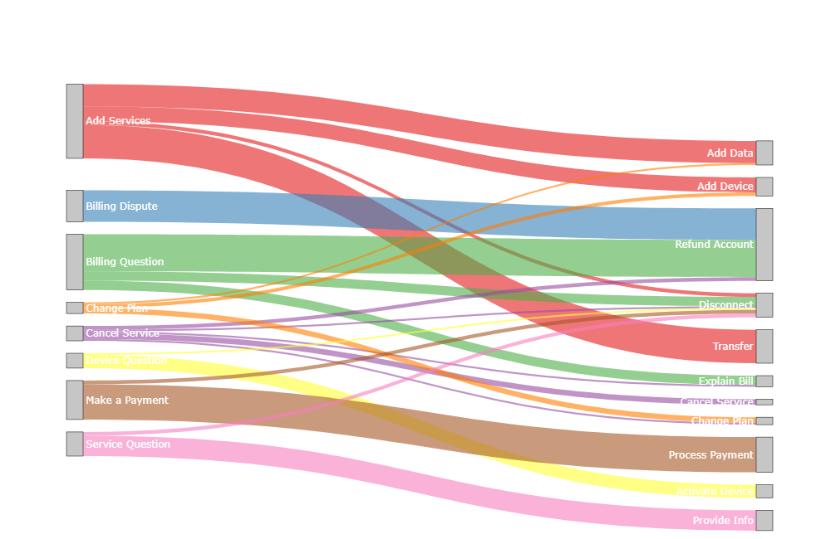
Add Services and Billing are the top contact drivers, with billing issues primarily resulting in refund requests.

Slide 29

04
Recommendations
What are some potential recommendations to improve the Customer experience?

Slide 30
Upskill Advisors
Enhance Self-Service Visibility & Effectiveness
Hire experienced advisors.
Train them to handle billing and other complex issues.
Guide customers to self-service.
Redesign self-service flows for billing and device questions.

Slide 31
Improve First-Contact Resolution
Get More Users Involved in the Survey
Simplify billing and refund resolution flows.
Provide advisors with clear billing/service FAQs.
Send brief, personalized surveys promptly via SMS or email.
Explain the purpose and consider reminders or small incentives.

Slide 32

What are the Benefits of Implementing these Recommendations?

Slide 33

Benefits of Implementation
Benefit 1
Benefit 2
Benefit 3
Boosting first-contact resolution and self-service usage reduces contacts volume.
Better advisor service and smoother resolutions enhance customer experience and satisfaction.
55% repeat contacts — resolving issues first time or through self-service channel saves big.

Slide 34
Thank you

